Slide 1

Apache Ignite
@thecodealchemist

Slide 2

What is Apache Ignite?
Distributed Database For High Performance Applications With In-Memory Speed

Slide 3
Features
Native Persistence(use as regular disk-based database)
Multi-Tier Storage
ACID Compliant
Distributed SQL
Compute, Services
Streaming
Messaging

Slide 4
Use cases
In-memory Cache
In-memory Database
In-memory Data Grid
Key/Value Store
High Performance Computing

Slide 5
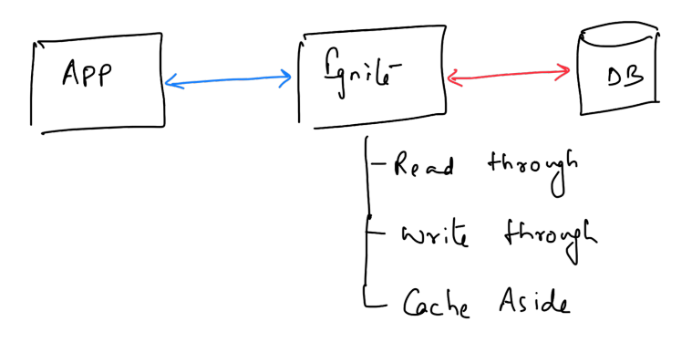
In-memory Cache

Slide 6
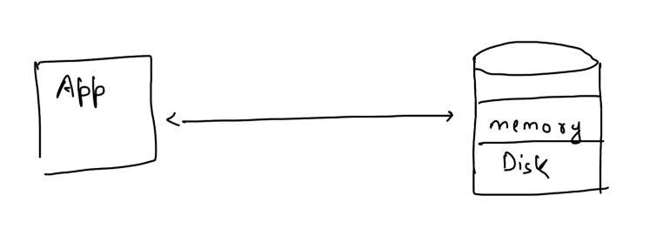
In-memory Database

Slide 7
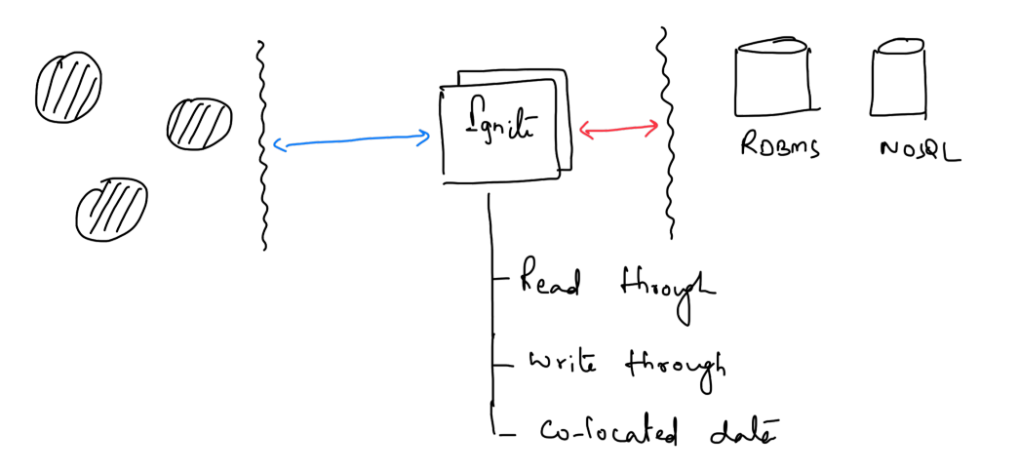
In-memory Data Grid

Slide 8
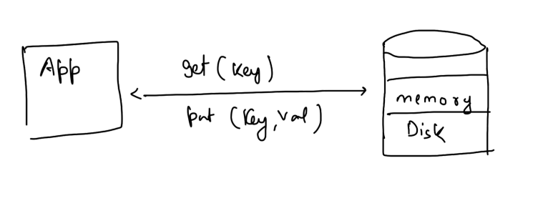
Key/Value Store

Slide 9
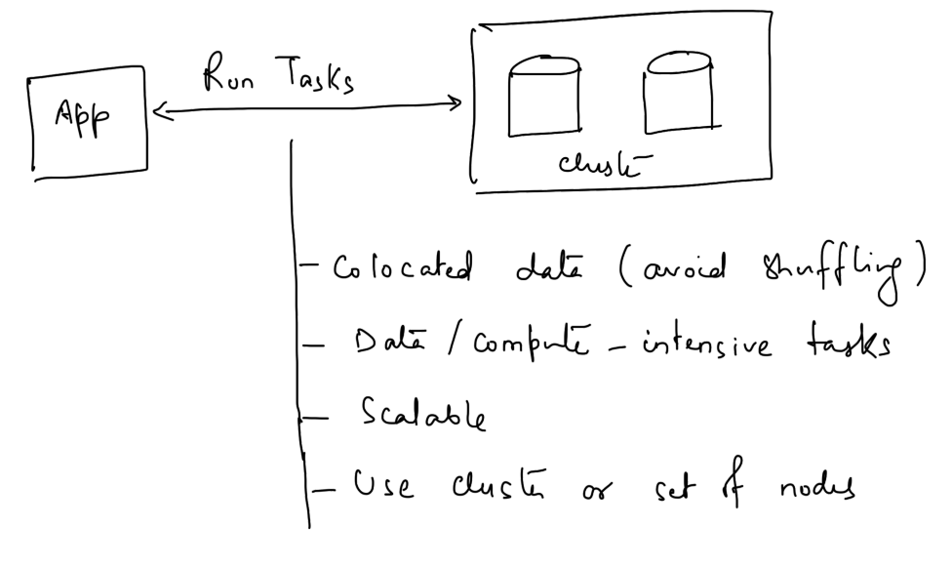
High Performance Computing

